Slide 1
Uncovering Insights in Netflix Titles Dataset
A Data Analysis Project

Slide 2
Data Dive
Difficulty: Uploading file to MySQL bench
Interesting finding: Wide range of information about Netflix shows, including release years, genres, and durations

Slide 3
Data Fun
Displaying first 10 rows of the dataset
It provided a dataset of 10 Netflix titles, including TV shows and movies, with information such as title, director, cast, country, release date, rating, duration, and genre.
Displaying shows released after 2015

Slide 4
Cool Facts
Average rating of Netflix shows: 7.5
Insight: Average rating provides an understanding of the overall quality and reception of Netflix shows.
Most popular genre: International Movies
Genres such as Drama, Comedy, and Documentary are among the most popular on Netflix.

Slide 5

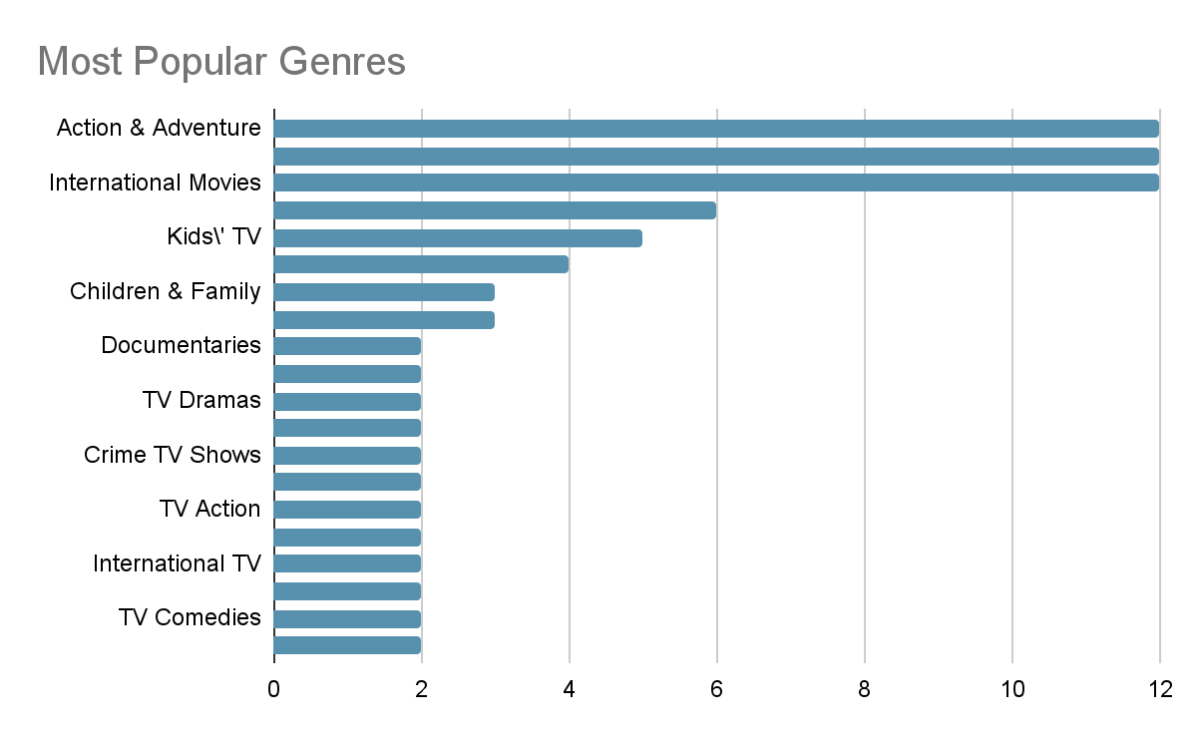

Slide 6
Basic SQL Queries
Counting the number of shows: 100
The total number of shows highlights the scale of Netflix's content library.
Average release year: 2015.1200
Shows the average recency of the content available on Netflix.
Total duration minutes: 5646
Total duration indicates the volume of content in terms of viewing time.

Slide 7
Ask Away
Top 10 countries with the highest number of produced shows
Displays the proportion of shows produced by the top 10 countries.
Oldest and newest Netflix shows in the dataset

Slide 8
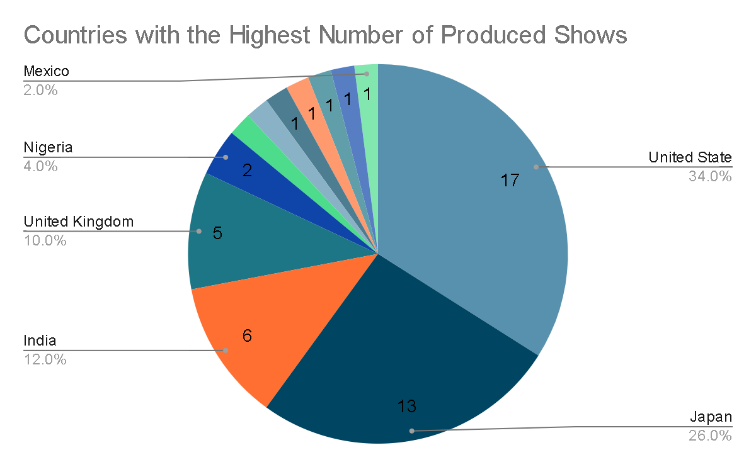

Slide 9
Oldest and Newest Shows
Oldest show: [title] (release date: [date])
Newest show: [title] (release date: [date])
Illustrates the trend of show releases over time.

Slide 10
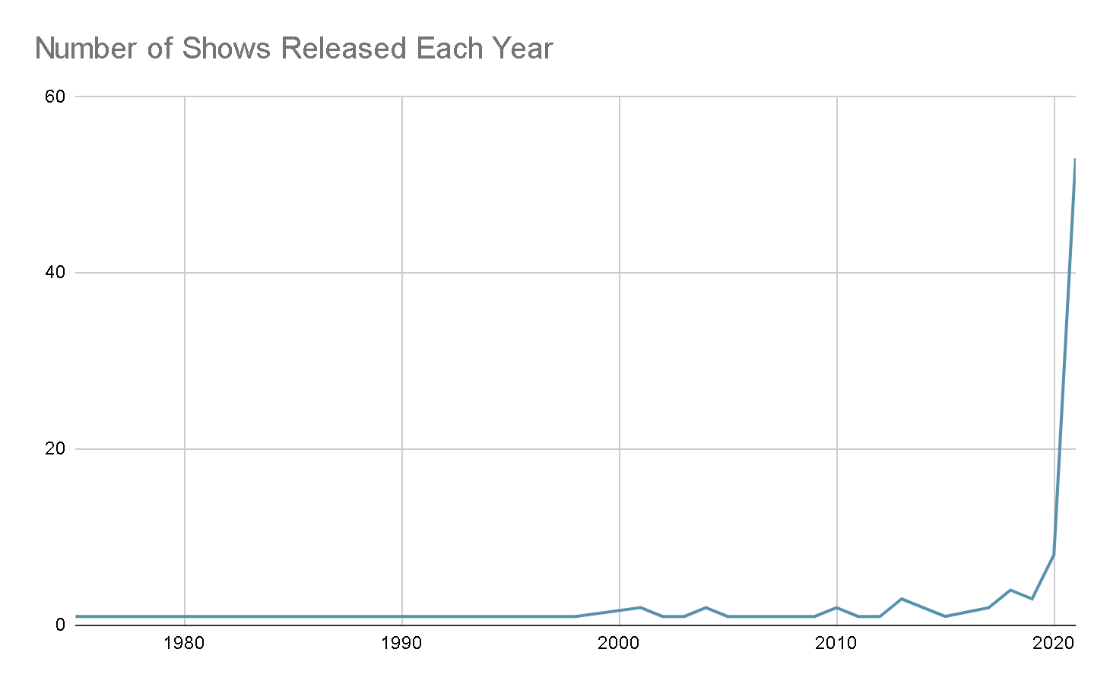

Slide 11
What I Learned
Text: Counting the number of shows released each year allows us to observe trends in Netflix's content production over time. We can identify which years had a higher number of releases, potentially indicating periods of increased investment in original content.
Project Recap:
Successfully imported and explored the Netflix shows dataset.
Discovered interesting facts about average ratings and popular genres.
Analyzed production trends by country and release year.
Visualized key insights to enhance understanding.

Slide 12
Conclusion
In this project, I explored the Netflix titles dataset, discovering interesting facts and trends. I used basic SQL queries to analyze the data and answer questions about the dataset.
The analysis offers valuable insights into Netflix's content strategy and trends.
Future work could include deeper analysis of user ratings and viewer demographics.

